Slide 1
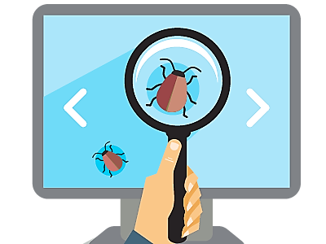

QA Introduction
Quality Assurance, Testing and Test Automation
SoftUni Team
Technical Trainers
Software University
https://softuni.bg
Notes:
Hello everyone. Welcome to the "Quality Assurance Introduction" lesson from the "Programming Fundamentals" training course at SoftUni.
I am doctor Svetlin Nakov, senior technical trainer and co-founder of SoftUni and I will teach this lesson.
I will introduce you to the software quality assurance basic concepts and technologies, such as:
the role of the QA engineers,
the lifecycle of software defects,
the software testing process and test types,
the test automation concepts, frameworks and tools,
and the concept of continuous integration and continuous delivery.

Slide 2

Table of Contents
Software Quality Assurance: Introduction
QA Engineers and Responsibilities
Bugs and Bug Trackers
Testing, Test Types and Test Levels
Test Automation, Frameworks and Tools
Continuous Integration and Continuous Delivery (CI/CD)
Notes:
I will start with explaining what is software quality assurance (QA)
and what activities it involves,
what is software testing, the types of software testing
and what are tools to perform testing.
Next, I will explain the role of QA engineers in the QA process,
their responsibilities and skills,
and their place in the software development process.
I will give live examples with typical job offers for QA engineers.
Next, I will explain the bugs (or defects) in software systems
and their lifecycle in software development.
I will demonstrate how bugs are reported,
then how they change their status over the time:
from "new" to "assigned", "fixed" and "closed".
I will show a live demonstration of "issue tracking software".
I will explain the concept of software testing,
the most used test types (such as functional and non-functional tests, white-box and block-box tests),
and the levels of software testing (such as unit testing, integration testing and system testing).
I will explain the typical testing process in software projects,
the concept of test plans, test scenarios and test cases,
with some real-world examples.
I will explain and demonstrate with live examples the concept of
software test automation and typical frameworks and tools used in it.
I will show you how to write unit tests using the Mocha framework,
how to write integration tests using Mocha and some other tools,
and how to write complete Web UI automation test with Selenium Web Driver.
Finally I will explain and demonstrate the concepts of:
continuous integration (CI),
continuous delivery (CD),
and will demonstrate how CI/CD pipelines can be implemented in GitHub Actions.
Let's begin.

Slide 3
Have a Question?
sli.do
#fund-common
Notes:
In case you have any question,
feel free to ask in the sli.do platform using the code on the screen,
and the trainers will be happy to answer you very soon.

Slide 4

Software Quality Assurance
Introduction
Notes:
In this section I will explain what is "software quality assurance",
its goals, concepts, principles, processes and tools.
I will introduce some QA concepts like:
QA engineering, software testing, bug reporting and bug tracking, test automation and continuous integration.

Slide 5

Software Quality Assurance (QA)
What is "software quality assurance" (SQA)?
Software quality assurance aims to assure that the software is bug free (behaves as expected)
QA engineers find defects by testing, and inspections
Defects are reported and tracked through a bug tracking system
Performed by the Quality Assurance engineers (QA engineers)
Most of the QA work is software testing
Manual testing (click and check the results)
Automated testing (QA automation)
Continuous integration and delivery (CI/CD pipeline)
Notes:
Software quality assurance (QA) aims to assure that:
the software works correctly,
is free of bugs (defects),
and behaves as intended.
Software quality assurance is an engineering discipline,
which applies principles, practices, processes and tools to ensure the software quality.
Professionals who implement and maintain QA processes are called "QA engineers".
QA engineers aims to
find the defects and problems in the software development,
earlier in the software development process,
before they reach the end-users.
They test and inspect the software
and monitor and track the development process
in order to find issues (which are also called bugs, defects or problems),
and to report and track them until they get fixed.
Defects and other issues are reported and tracked through
a bug tracking system (also called issue tracker).
In the bug tracking system issues are first logged,
then developers work and fix them
and finally the QA engineers verify and close them.
The software QA activities (such as software testing, bug reporting and tracking and test automation)
are performed by the Quality Assurance engineers (QA engineers).
QA engineers are technical members of the development team,
who are responsible for the software quality.
QA engineers plan, design, automate and execute tests and review the test results.
When an issue is found, it is reported in the issue tracking system and is tracked until resolved.
QA engineers, together with developers implement
the process of automated testing, continuous integration and continuous delivery.
Most of the QA work is software testing.
Software testing is the process of examining the software with set of tests to ensure the it works correctly and is bug free.
Test techniques include the process of executing a program, service, application or system with the intent of finding software bugs (errors or other defects) and verifying that the software product is fit for use.
Testing can be performed manually by hand or can be automated (programmed as script).
Testing can cover a single function or component, the integration between several components or the entire system.
Testing can be black-box (testing without looking inside the code) or white-box (read the code and test suspicious pieces of it).
Testing can be functional (test certain use-case) or non-functional (test the performance, compatibility or security).
Manual testing is "testing by hand".
It consists mainly of "clicking on the user interface, filling the forms and checking the results".
Manual testing is preferred for testing quality aspects, which cannot be easily automated, such as:
usability testing (checking whether the user interface is user-friendly and easy to use),
compatibility testing (checking whether the user interface behaves correctly on different hardware devices, operating systems, Web browsers and environments),
system testing and acceptance testing (testing whether the entire system works as expected).
Manual testing is done by manual QA engineers, which typically follow preliminary prepared test scenarios.
Automated testing (QA automation) is widely used in modern software development.
Automated tests are programs or scripts, which test certain functionality or quality aspect of the software.
Once written, the automated tests are executed continuously many times,
and they ensure that the tested component or subsystem works in the same way over time,
regardless of code changes during development.
Re-executing the same tests to confirm, that the code changes do not affect already tested software,
is called "regression testing".
Automated tests are either written by developers or by QA engineers.
Automated tests usually test the functionality of the system (whether it behaves as expected).
Automated tests can cover a single function or component (unit tests)
or the interaction between components (integration tests).
Continuous integration and continuous delivery (the so-called CI/CD pipeline)
is a practice in modern software development,
where the code is integrated, tested and deployed continuously
and automatically after each significant change in the code.
Continuous integration (CI), together with automated testing
allows developers to find the bugs early
and to continuously maintain the quality of the software.
Continuous delivery (CD) is a practice in modern software development,
which allows to integrate, deploy and release new features continuously
in short release cycles with a lot of automation.
The continuous integration and continuous delivery is often used together in a CI/CD pipeline,
which I will explain and demonstrate later.

Slide 6
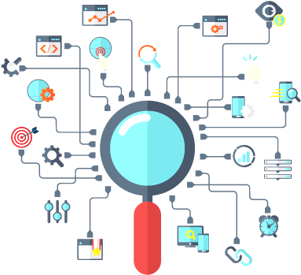
The QA Role and Its Responsibilities
Notes:
In this section I will explain the role of the QA engineers in modern software development.
I will explain the responsibilities of the QA engineers,
how do they ensure the software quality,
the QA activities they perform
and the QA processes they maintain and monitor.
I will mention some testing activities,
such as designing and executing test cases, and test automation,
bug reporting and bug tracking,
and tracking the quality of the development process.

Slide 7
Quality Assurance (QA) Engineer's Role
QA engineers ensure the software quality
Plan and execute testing activities
Test the software, its functionality, UX and usability, etc.
Create test plans, design test cases, execute tests
Develop and execute test automation scripts
Report and track bugs and their lifecycle
Perform regression testing when bugs are resolved
Track the development process and its quality
Review the requirements, design and code
Build and monitor CI/CD pipeline, track QA metrics
7
Notes:
Quality assurance (or QA) is an important role in software engineering.
It is played mainly by QA engineers and partially by software developers.
QA engineers ensure the software quality.
This involves software testing, bug tracking, and tracking of the development process.
QA engineers plan and execute testing activities.
This involves preparation, execution and automation of different types of tests,
reviewing the test execution results and logging the bugs in the bug tracking system.
QA engineers test the software, its functionality, UX and usability, performance, etc.
QAs perform functional tests (checking whether the functionality works as expected),
UX and usability tests (checking whether the user interface is easy to use),
non-functional tests (testing performance, security and compatibility) and others.
QA engineers create test plans, design test cases and execute tests.
Test plans describe what and how to test, test scenarios, schedule and other organizational activities around testing.
Test scenarios describe certain use case or functionality to be tested.
A test scenario is covered by multiple test cases (for example, with valid input and invalid input).
QA engineers execute the tests and evaluate the execution results, and report the issues found.
QA engineers develop and execute test automation scripts.
Test automation is an important activity in modern software testing.
Test automation consists of writing a program or script that executes set of test cases.
Test automation uses testing frameworks and tools
that simplify the implementation of different types of tests,
automate their execution and reporting of the results.
Test automation QA engineers are professionals who have both developer and QA skills.
They work closely with the entire development team to automate the testing activities or pieces of them
and build and maintain continuous integration and continuous testing environment.
QA engineers report and track bugs and their lifecycle.
Once a bug is found, the QA engineers report it in the bug tracking system,
together with a detailed description and steps to reproduce it.
The bug stays in the bug tracker and is accessed by developers, QAs and team management.
Its status changes over time, depending on the efforts and activities to fix the bug.
The bug is initially "new", then is "assigned" to someone, then is "fixed" and finally is "closed".
QA engineers perform regression testing when bugs are resolved.
This means to re-check features and functionalities that worked in the past,
whether they still work correctly after another bug is resolved.
This reduces the chance of introducing new bugs with the fix of some existing bug.
QA engineers track the development process and its quality.
This is quite complex activity.
The development process consists of philosophy, practices, processes and tools for developing software.
QAs track whether the developers follow the established processes (like weekly sprint planning),
the established practices (like using correctly the bug tracker and writing unit tests),
and whether the development follows the established workflow.
QAs also establish and monitor QA metrics, which measure the quality and progress of the project.
QA engineers review the requirements, design and code during the development.
QAs review the requirements to ensure they are well defined and in sync with the business case.
QAs perform design and code inspections
to check whether the established conventions, rules and practices are followed.
QAs review the UI design prototypes to ensure the UX and usability of the planned features.
QA engineers build and monitor continuous integration and continuous delivery (CI/CD) pipeline.
Continuous integration (CI) is the process of automated building and testing of the software
after each commit in the master branch.
This ensures that the new code integrates correctly with the existing code:
compiles without errors and passes all existing automated tests.
QAs are involved to track the quality metrics during the development,
such as test coverage (or code coverage),
defect rates, mean time to detect and mean time to repair defects,
burn down chart, and many others.

Slide 8

QA Job Ads
Live Demo
https://jobs.livecareer.com/l/qa-engineer-calendly-c0d3e44eb75865c2ee6bd4ada20612de
https://www.indeed.com/viewjob?jk=534ebdec45075857
https://www.linkedin.com/jobs/view/1949370301
Notes:
To demonstrate the typical requirements for the software quality assurance engineers,
we shall review several QA job advertisements from the software industry.
Our first example is a job advertisement for a "QA engineer" in Calendly, posted in LiveCareer.
Calendly is a company building online software for scheduling appointments.
The ad starts with introduction to the company:
"Changing how the world schedules".
The next section "About the opportunity" explains what they look.
As a QA Engineer, you will be responsible for testing new features and functionality.
Software testing, and more precisely, functional testing, in on focus here.
Will work closely with Development Engineers and Product Managers in an Agile environment.
Team collaboration and agile development process is on focus here.
Define user stories and acceptance criteria as well as testing new feature functionality.
Review requirements and perform feature testing and acceptance testing is on focus here.
They mention "functional testing".
Our ideal candidates are analytical with a keen eye for detail and obsession over quality.
Soft skills, such as analytical thinking and attention to details are on focus here.
This role will be responsible for logging and monitoring errors, and testing performance and load-time.
Bug reporting and bug tracking is on focus here.
Also they mention performance testing, which is an example of non-functional testing.
You’ll have the opportunity to design automation solutions for large scale projects including unit tests, API tests, and functional/GUI tests.
Test automation is on focus here, and more precisely:
automated unit tests, automated API tests, automated functional tests and automated UI tests.
We read further… Some challenges: analyze product requirements and architect test plans.
They mention "test planning".
Write, validate and execute test cases.
This is what most QA engineers do most of the time.
Track defects and provide quality metrics.
They mention bug reporting and bug tracking, together with tracking quality metrics.
Contribute to our suite of automated browser-based regression tests.
Regression testing through automated Web UI tests is on focus here.
Let's read further…
Strength in one or more automation testing tools (e.g. Selenium, WebDriver, JMeter, SoapUI, Watir).
They require experience with test automated frameworks and tools.
Knowledge of best practices and standards for web applications.
This is purely Web development expertise.
Proven ability to translate functional requirements and use cases into working test plans and test cases.
Designing test scenarios and cases, that cover the requirements, is on focus here.
Experience with GitHub, Use of 1 or more scripting languages like JavaScript or Python …
These are again purely software development requirements.
I already explained that QA engineers are developers with focus on software quality.
Experience in a DevOps environment, with a good understanding of CI/CD.
The focus here is on building and monitoring the continuous integration
and continuous delivery, the CI/CD pipeline.
Experience validating API services using tools such as Postman.
They talk about API testing (manual and automated).
Clear understanding of the differences between unit, functional, integration, and system tests.
They mention the test levels in software testing, which I will explain in detail later.
Experience with Agile development.
Modern software development is agile, and QAs are deeply involved in the process.
This is what a typical modern software development company wants for the "QA engineer" position.
Let's review the next job advertisement:
"Software QA Engineer" at Global Tracking Communications LLC, posted at Indeed.
The job description starts with the following:
GPS Trackit is seeking an experienced Test Automation Engineer
to develop and implement automated test suites
to test our web and mobile applications.
This company, like many others, assumes that
"QA engineer" means a developer, who writes automated tests to ensure software quality.
In this certain case, they want to automate their Web and mobile application testing,
with integration tests, API tests, UI tests and system tests.
Responsibilities:
Building comprehensive test suites.
They want to cover the entire apps with automated tests.
Creating regression tests for issues that are found to ensure they do not reoccur.
Writing automated regression tests is mentioned here.
Requirements:
Proven experience building automated test suites.
The focus here is on test automation.
Experience with mainstream automation suites such as Selenium and Appium.
They mention the most popular automated Web and mobile testing tools.
Experience integrating test automation into CI/CD.
Knowledge, skills and experience with continuous integration (CI) and continuous delivery (CD) is required here.
Let's see yet another QA job advertisement:
Software Development Engineer in Test III at Healthwise, posted in LinkedIn.
What they require?
Develop software to support Healthwise’s testing efforts.
They most probably mean writing and maintaining automated tests.
Good development skills.
They need a developer with QA specialization.
Requirements duties & responsibilities:
Develops, documents, and maintains automated tests that align with product requirements, features, and product dependencies.
Automated testing is on focus here.
Reviews product requirements and specifications and recommends improvements to ensure product testability.
Review the requirements is on focus here.
Delivers accurate and maintainable code for test automation and software utilities.
Writing high-quality automated tests is on focus here.
Assists in creating and maintaining Continuous Integration (CI) and Continuous Deployment (CD) delivery models.
I already mentioned the CI/CD pipeline and the role of QA engineers to build and maintain it.
This requirement here mention exactly the CI/CD pipeline and the delivery model based on it.
Qualifications:
2+ years hands on experience in object-oriented test automation.
Again: the focus is on test automation (writing automated tests in object-oriented programming language).
4+ years of industry experience testing software and test creation.
They require solid experience in software testing (manual or automated).
You can see the spirit of this job offer: it is somewhere between software development and software quality assurance.
This is what most modern software development companies need: test automation engineers.
They need software developers who are dedicated to software quality and automated software testing.

Slide 9

Defects, Bugs, Issues
Issue Tracking Systems
Notes:
In this section I will explain and demonstrate how QA engineers report and track defects during the software development.
I will discuss the defect lifecycle and how issues get reported, assigned, fixed and closed.
I will explain the concept of defect tracking systems (issue trackers)
and will demonstrate the GitHub Issue Tracker with issues form a real-world project.

Slide 10
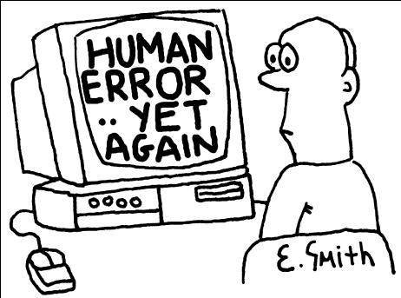
Software Defects
Humans can make errors (mistakes)
Errors produce defects
Defects are bugs in the program code, or mistakes in the requirements / design / other
If a defect is executed, it might cause a failure:
Fail to do what it should do / do wrong thing
QA / software testing aims to find the defects
Automated testing and CI/CD reduce the defects
Notes:
Let's talk about software defects, bugs, failures and testing.
Humans can make errors (mistakes) when they design and implement software.
Typically errors are related to something written incorrectly in the code,
or in external library or component or incorrect integration.
Errors can also be in the software requirements:
When developers don't understand well the requirements, they can code incorrect program logic.
Errors can be due to wrong assumption about the input data or input conditions.
Errors can be due to lack of skills, fatigue or lack of concentration.
Errors produce defects in the software.
Defects are bugs in the program code, or mistakes in the requirements, design, implementation, integration of components, deployment, configuration or somewhere else.
Defects are problems in the software, that prevent it to work as expected.
If a defect is executed, it might cause a failure:
A failure is to fail to do what is expected or do a wrong thing.
This is a manifestation of the defect, the unexpected, wrong behavior in certain situations.
Software quality assurance and software testing aims to
find the defects in the software, before they cause failures
or to find the root cause, when a failure has already occurred.
Quality assurance engineers (QAs) work together with the software developers to
reduce the defect rate in the software and increase its quality.
They perform different types of software testing and code inspections to find and prevent defects.
We shall talk about testing more seriously later.
Automated testing, continuous integration systems and CI/CD pipelines,
dramatically and persistently reduce the defect rates,
especially when the code is well covered by automated tests.
We shall learn more about how to use continuous integration systems later.

Slide 11
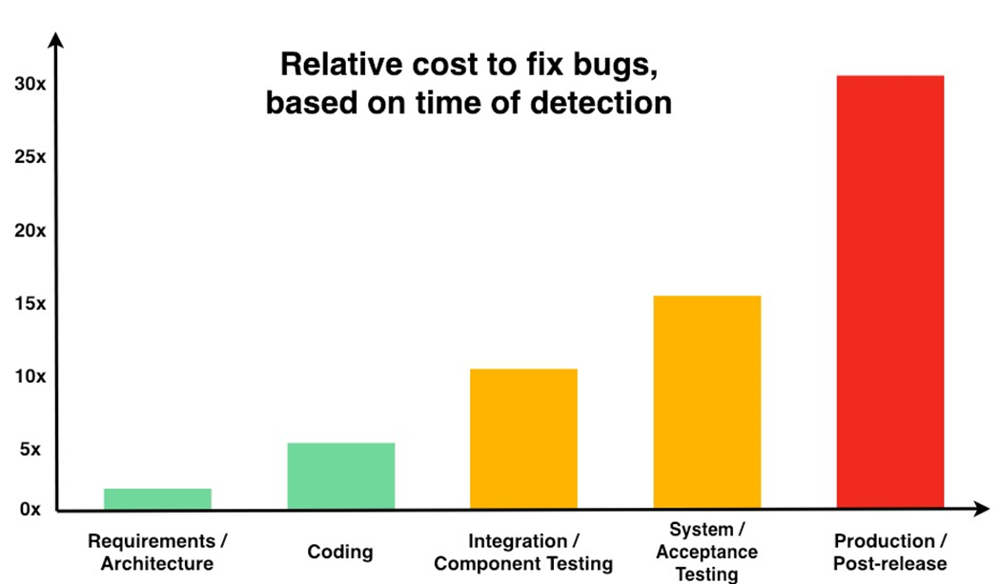
The Cost of Software Defects
Defects cost less when found earlier
Agile practices (like CI/CD) find defects earlier
Notes:
An important rule in software quality is that "defects cost less when found earlier".
Fixing a defect when you write the code costs significantly less than fixing the same defect later,
when the software is already released and shipped to the end users.
The following diagram illustrates the typical cost of defects during the different phases of software development.
Defects found early in the requirements are easily fixed:
The requirements are updated and that's all.
Defects found when developers write the code are also easy to fix:
The code is updated to fix the bug and that's all.
Fixing existing code costs more than fixing wrong requirements before the code for it is written.
Defects found later when developers integrate their code with the code from other developers cost more.
This is because the code is already written, and it looks correct but cannot work together with the other code.
In this situation the code should be redesigned and adjusted in order to be integrated with the other code.
This usually costs much more than fixing a bug before the integration.
If the problem is in the requirements and is found during the integration, to fix it developers should write new code, integrate it and test it again.
Defects found during the system testing usually cost even more, because they break the entire system.
Fixing such a problem may need to make changes in several interconnected components and this will take more efforts.
If the problem is in the requirements and is found during the acceptance testing, to fix it developers should write new code, test it, integrate it, test the interconnected components, and test the entire system again. This costs a lot of effort.
When a software is released and shipped to the end users,
fixing bugs (especially in the requirements) costs much, much more.
Imagine that we have a mobile app, which runs on millions of devices and it collects wrong data from the user.
To fix the problem, developers should redefine the requirements correctly, then write new code, then test it, then integrate the new code with the existing code, then test the integrated components, then test the entire system, then release a new version of the software.
The new version of the mobile app will take time to be installed by all users.
Meanwhile, some users will report correct data (using the updated app), others will report wrong data (using the old version of the app).
The back-end components should handle correctly both cases for very long time.
Additionally, the wrong data, already collected should be either updated or discarded, which costs more developer effort.
Releasing buggy software to the end users may be very, very expensive (depending on the case).
Agile practices (like CI/CD pipelines), automated testing with high test coverage, well organized development process and QA process and many other QA practices aim to find defects earlier.
Finding defects earlier usually costs less.
It costs effort to test the software consistently and find the defects earlier.
If the impact (or the damage) of the bugs is high, it is better to spend more time on testing.
If the impact of the bugs is low, it might be better to leave them reach the end user.
Many companies and projects cannot afford releasing buggy software
and they put a lot of efforts on the quality control
and on the QA process and QA practice.
Other projects (such as proof of concept work or internal company tools)
could afford to be imperfect and to be released buggy,
and such projects spend less time and resources on software quality.
It highly depends on the project and the quality requirements, set by the management.
In some projects different quality requirements are established for different components of the software system.
For example, the public site or app of e-commerce system should be stable and free of bugs to generate orders.
Bugs in the sales process or in the payments subsystem directly costs loses,
so these components are typically heavily tested.
In the same time, the admin interface for the warehouse workers could be imperfect.
They will find a way to overcome the bugs and do their job, even if the software is buggy.
Most companies invest more on the quality of the software, which customers touch,
and less on software used internally.
Remember that finding defects earlier will cause less damage,
so put enough effort to find and prevent defects before they reach the end user.

Slide 12
Bug Tracking and Issue Lifecycle
Software defects / bugs / problems / issues
Are tracked in issues trackers (bug trackers)
QA engineers manage the issue lifecycle
Issue lifecycle
New → Assign / Reject → Fix → Verify → Close / Reopen
New
Rejected
Review
Assigned
In-progress
Reopen
Fixed
Verify
Closed
Notes:
Let's discuss the bug tracking software systems (issue trackers) and the typical issue lifecycle in software development.
Software defects (also known as bugs or problems or issues)
are tracked in issues trackers (bug trackers, or bug tracking systems).
When a bug is found in the software, it is usually reported in the bug tracker
by the QA engineers, developers or end users.
Then the bug begins its lifecycle in the bug tracking system.
QA engineers, together with developers, manage the issue lifecycle, in the issue tracking system (the bug tracker).
The issue lifecycle is the transition of the issue from new to assigned, fixed and closed,
reflecting the work progress towards addressing the issue.
Let's review the typical issue lifecycle in most software projects:
The issue starts from "new",
then is assigned or rejected,
then is fixed by developers and
the fix is then verified by QAs,
and finally is closed or re-open.
When an issue is first reported in the issue tracker, it gets a status "New".
New issues are waiting for someone to handle them.
A team member (QA engineer, developer or the project owner) regularly reviews the new issues
and decides how they will be handled.
A new issue can be either accepted (as valid problem for fixing) or rejected (as invalid problem or problem, refused to be fixed).
Rejected issues are closed and are removed from the waiting queue of open issues.
An issue can be rejected
when it is invalid (not a bug),
or is not described in understandable way,
or if the team has no resources to address it.
When a new, recently reported issue (which is waiting in the tracker), is accepted as valid problem,
it can either be assigned to some develop
or can just stay open in the issue tracker.
Issues can be assigned to certain developer or groups of developers.
The reviewer decided to whom to assign the issue,
based on complexity of the problem, and the skills and schedule of the team members.
The issue can also be accepted, without assigning a certain developer to handle it.
This depends on the internal team policy and on the characteristics of the issue.
Later, at some time a developer takes the issue to work on it, in attempt to fix it.
At this time, the issue get a status "in progress" or "taken".
It may several hours or days for an issue to be fixed.
During this period, the issue stays usually assigned or self-assigned to some developer.
This prevents the other developers to work on the same issue in the same time.
When the work on the issue is completed, the developer changes its status to "fixed".
"Fixed" means that the issue is ready to be tested.
In some teams, developers test the fixed issue themselves and directly close it.
In most teams, QA engineers test the fixed issue and confirm whether it works correctly.
If a fixed issue is successfully verified by the QA, it is closed.
A closed issue is a completed issue, a problem that was successfully fixed and no longer exists.
In most development teams, issues cannot be directly closed
and should be verified by the QA engineers and by the business or project owner.
This ensures that problems are fixed with high quality,
and the fixes are stable and don't cause side effects.
If an issue is reported as fixed, but during the verification it is found to be buggy or not fully fixed,
the QA engineer (or project owner) writes a comment and re-opens the issue.
The issues with rejected fixes change their status back to open, accepted or assigned.
Later, the same developer who made the fix (or another developer),
takes the issue again, works on it and marks it as "fixed"
and the QAs verify the new fix and close or re-open the issue.

Slide 13

Issues
QAs report, describe and track issues in an issue tracker
Issues hold the following information:
Title and description (with steps to reproduce)
State: open / closed
Status: new / assigned / rejected / fixed / verified
Priority: low, medium, high, critical
Assigned team members
Discussion / comments
Notes:
Now, it's time to explain in greater detail
what's inside an issue in the issue tracker,
and what fields and information issues should hold to be understandable,
and how their state, priority and status changes during their lifecycle.
QAs, developers and project owners (the business representatives) report issues
when they find a bug or a problem or just have a proposal for a new feature.
Issues are described as trackable entities in the issue tracking system.
Each issue has title and description.
The title summarizes the problem in few words.
The description describes the problem is a way, which is understandable for the team members.
The description could hold screenshots, video recordings, attached files and other resources, which help to describe the problem.
From the description should be obvious how to reproduce the problem.
Some team policies require explicit sequence of "steps to reproduce the problem".
Issues have automatically assigned by the issue tracker author and date of reporting.
Most issue trackers maintain a full history of changes and visualize who and when makes changes.
The state of an issue can be open or closed.
Open issues are "active": waiting to be fixed, or under development, or are fixed and are waiting for verification.
Open issues comprise the "active queue",
which holds the pending work for the development team.
Closed issues are already completed.
They stay out of the "active queue", as history records.
They are either resolved or rejected, and the work on them is finished.
The issue status describes its position in the bug fixing lifecycle:
The status for open issues can be new, assigned and fixed.
The status for closed issues can be verified or rejected.
Issues can have priority.
This is the importance of the problem from the business perspective.
Priority can be low, medium, high and critical (which is very high and urgent).
Some teams use different set of priority identifiers.
In some project teams differentiate between priority (how urgent is the problem) and severity (its impact on the system).
Issues can have one on several assigned team members.
These are the team members, who are assigned to address the problem.
Usually, this is the developer, who works most closely with the feature, which has failed.
Discussion and comments are used in every issue tracking system to clarify the issue description and efforts to resolve the issue.
Sometimes developers ask the issue author for clarifications, in order to understand better the problem and the expected behavior.
Sometimes issue authors add comments to help the assigned developers to understand the problem or to reproduce it.
Sometimes QA engineers add comments to help the developers to pay attention to something they did not notice.
The issue tracker is like an internal discussion forum for the development team,
where users share their problems and get help from the other users.
Public open-source projects have public issue tracker.
Private projects have internal issue tracker, which is not public.

Slide 14

Issue Tracker
Live Demo
https://github.com/twbs/bootstrap/issues
https://github.com/twbs/bootstrap/issues/31392
https://github.com/twbs/bootstrap/issues/31459
Notes:
It's time to look at a sample issue tracker from the real world.
The first link above opens the public issue tracker of the "Bootstrap" project,
which is a popular responsive design framework,
which simplifies styling Web sites with CSS.
Let's see what's inside.
We have a few hundreds of open (waiting) issues
and a few thousands of closed (completed) issues.
In the GitHub issue tracker, issues have title, description, labels and comments.
Some issues can have also assigned developer, attachments, project and milestone.
We click on the second link.
It holds an open issue.
Let's view what's inside it.
This is a discussion that begins with a description of the problem and then comments follow.
Developers discuss the problem and its specifics.
We click on the third link.
It holds a closed issue.
Closed issues are similar, but they are either fixed or rejected (refused to be fixed for some reason).
This issue is closed: it is reported to be successfully fixed.

Slide 15
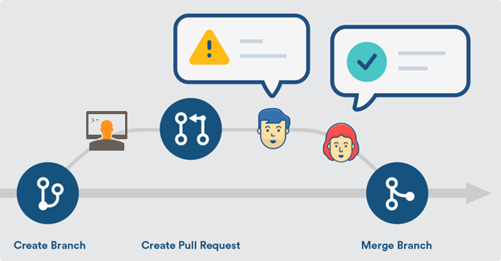
Typical Flow for Handling an Issue
An issue is logged by someone
A developer is assigned to fix it
А new branch is created for the fix
The developer makes changes and fixes in this branch (writes code, commits changes, pushes the changes)
When ready, the developer sends a pull request
Other developers review / comment / approve
The changes are merged in the upstream branch
Notes:
Let's now review the typical flow for handling an issue,
used by most developers in GitHub.
The process starts when an issue is logged by someone in the issue tracker.
The issue author could be a QA engineer, a developer
or a businessperson, involved with the product development,
or an end user, who used the software.
At some time, a developer is assigned or self-assigned to fix the issue.
Taking an issue and starting work on it is usually done according to the
current team priorities and often is coordinated with the management.
At start, the developer creates a new branch in the development repository for the assigned issue.
The work on the fix can take several hours or several days
and the work in progress can be committed in the new branch.
Working on a separate branch is a good practice,
because it isolates the work on the current issue from the concurrent changes by other developers.
It also isolate the other developers from dealing with the changes in the current branch.
During his work on the assigned issue, the assigned developer makes changes and fixes in the working branch.
The developer writes code, commits changes and pushes the changes in the branch of the current issue.
This can take a few hours, days or even months.
When ready with the fix, the developer sends a pull request.
The developer first fixes the problem,
then tests locally on his computer the proposed changes
and verifies that the new code is working properly
and does not break the other features.
At this moment, the fix is ready for integration in the upstream branch.
Then, the developer sends a pull request.
This is a request to merge and integrate the new code into the upstream branch.
This upstream branch is in most cases the main product development line (the master branch).
Next, the pull request enters in the "pull request queue" for the project.
This is a queue of proposed changes that need approval.
Other developers review, comment and approve the new code.
They can either approve the changes or reject them or write a comment and postpone the approval.
Like the project issues, the project pull requests are subject of tracking, reviews and online discussions.
Finally, some team member approves the pull request and
the changes get merged into the upstream branch.
Merging the changes is the final step when the work on an issue is completed.
Merging can be done by the developer who created the pull request or by some other developer.
Merging can be conflict-free or can require the merge conflicts to be first resolved.
Looks complicated, but development teams from all over the world use the above described development workflow.
This is how modern software development works:
with issues, with separate branches for each issue and with pull requests.
This is a proven best practice, also known as "GitHub Flow",
and it is highly recommended by GitHub.
You can learn more about the GitHub flow at https://guides.github.com/introduction/flow/.

Slide 16
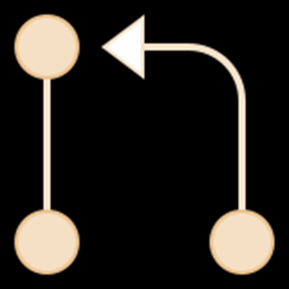
Pull Request Merge
Live Demo
https://github.com/twbs/bootstrap/pull/31396
Notes:
This real-world example will demonstrate you what a "pull request" is and how it works.
We open the above link.
It is a sample "pull request" from the "Bootstrap" open-source project.
As we can see, this pull request fixes and closes certain issue from the bug tracker.
The pull request has a title and description, just like project issues.
It holds a discussion and approval from two separate team members,
displayed in the [Conversation] tab.
We can see the commits, which take part in this pull request.
in the [Commits] tab.
We have two commits: one from the author of the fix and one from another contributor.
In the [Checks] tab we can see the actions from the continuous integration process,
which were executed automatically by GitHub during the merge of the pull request.
All these "checks" were passed successfully.
In the last tab [Files changes] we can see the changes in the source code, caused by this pull request.
This is the actual fix in the source code for resolving the assigned issue.

Slide 17

Software Testing
Test Types and Test Levels
Notes:
Software testing is the QA main activity, that ensures the software quality.
In this section, we shall discuss the test types, test levels and the testing process.
We shall explain the different types of tests, involved in software testing,
such as functional and non-functional testing,
black-box and white-box testing,
manual and automated testing.
We shall explain the concept of different test levels, which include
unit testing, integration testing and system testing.
We shall discuss the software testing process, which involves several steps such as:
test planning,
test development
and test execution.
We shall also explain what is a test scenario and how it is covered by several test cases.

Slide 18
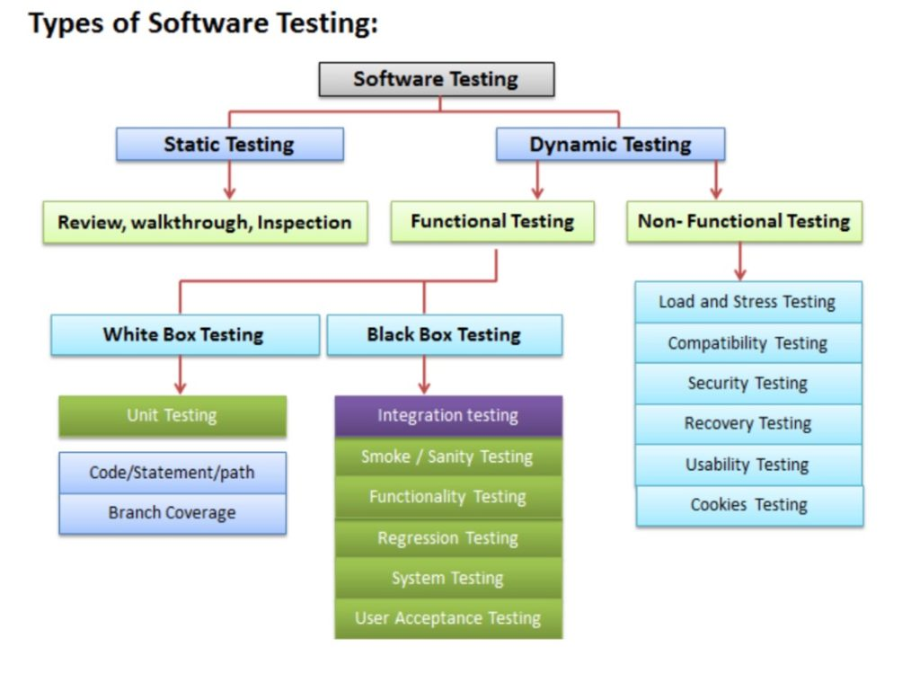
Software Testing and Test Types
Testing checks whether software conforms to the requirements, aims to find defects
Types of software tests
Functional and non-functional
Black-box and white-box tests, regression tests
Stress tests, load tests, UX and usability tests, security tests
Manual vs. automated tests
Notes:
Software testing checks whether software conforms to the requirements.
This means to check whether the software does what it should really do,
and if it does it correctly, without side effects, without bugs, hangs or crashes,
whether its behavior is stable,
whether the performance is good,
whether the user interface and usability are good
and many other quality aspects.
Software testing is a tool to reduce the defect rates.
Testing aims to find the defects and report them for fixing.
When the software is well tested, the chance for undiscovered defects is low.
When the software is not tested at all, or is not well tested,
there is a high chance for defects to appear during its execution.
Software testing uses many different types of testing.
Testing techniques can be static and dynamic.
Static testing is based on code reviews and inspections,
which find potential problems,
without running the code.
Dynamic testing is based on examining the code in action:
run the software and check for problems.
Testing can be functional and non-functional, depending on what we test.
Functional testing checks whether the software works correctly, according to the requirements.
It check the functionalities of the software by executing certain features
with different input data and entrance conditions
and evaluating the behavior, output data and exit conditions.
Functional testing can be based on different black-box techniques and white-box techniques,
can be performed manually or can be automated.
Non-functional testing checks quality aspects, which are beyond functionality.
Non-functional testing include usability testing, performance testing, security testing and others.
Testing can be black-box and white-box,
depending on how we design the tests.
Black-box testing checks whether the software behaves correctly,
regardless of the details how it is internally implemented.
During the black-box testing, the software is used as a "black box", which is closed, and it is unknown what's behind the cover.
Anyone can perform black-box tests, without having access to the source code.
The tester chooses input data and entrance conditions,
in attempts to cover the main case and the special cases (such as boundary values and state transitions),
but without having information about how the software works internally.
White-box testing is based on inspecting the source code
and looking for suspicious fragments in it,
then designing test cases to check the suspicious code.
In white-box testing an internal perspective of the system,
as well as programming skills,
are used to design test cases.
The tester chooses input data and entrance conditions,
based on the execution paths, visible from the source code.
Regression tests check whether a functionality, which worked correctly in the past,
still works correctly, after the code is changed or refactored.
Stress tests, load tests and performance tests,
check how the software behaves under heavy load,
under unusual environmental conditions
and whether it meets the performance requirements
(such as maximum page load time).
UX and usability tests check whether users can use the software with ease,
whether they find how to do something without explicit training and
whether users are satisfied with the user interface and user experience.
Security tests check different security aspects of the software, such as
security vulnerabilities, software misconfigurations, incorrect encryption, and others,
which can lead to unauthorized access, data leakage and other damage.
Depending on how tests are executed, they can be manual and automated.
Manual tests are executed by people, by hand.
Testers run the software, click on the user interface, fill forms, submit data and try to find defects.
This is done by hand, or with the help of some tools, but the tests are executed by a human.
Manual testing can be done ad-hoc or following a preliminary prepared execution steps.
Automated tests are programs or scripts, which test some feature or quality aspect of the software.
They can be manually or automatically executed, as part of the CI/CD pipeline.
Automated tests always follow preliminary designed test scenarios and test cases, implemented as code.
Most of the quality aspects of the software can be automated, but not all.
Some types of testing can only be done by humans, due to their nature.
For example, functional testing and performance testing can be fully automated,
but UX and usability testing should be done by a human.

Slide 19
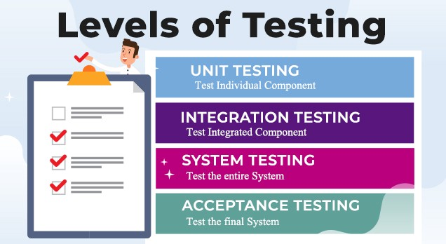
Test Levels
Unit tests
Test single component
Automated by developers
Integration tests
Test interaction between components
System tests / acceptance tests
Test the entire system
Notes:
Software testing is done at several levels:
unit testing, integration testing and system testing.
A unit test is a piece of code, written by developers,
which tests a certain use case of certain software component.
Unit tests test a single component (called "unit").
This can be a function or method in the code, a class or other code component,
which should be isolated from its dependencies.
Integration tests check the interaction between several components.
The difference between unit testing and integration testing is that
unit tests examine the functionality of a single, isolated unit with simulation of the external dependencies,
while integration tests examine the functionality on several units together
and test the integration between the dependent units.
System tests and acceptance tests test the entire system: all its components together.
System tests are manual or automated tests, which cover end-to-end scenarios:
from the front-end, to the back-end, the database and all other system components.
Acceptance testing is an extension to system testing, where
the QA team or the project sponsor checks how the product will perform
when it is installed on the user’s system.

Slide 20


Unit Tests
Unit tests
Pieces of code, which test single component (unit)
E.g. test certain function or method in the code
Example: test the user registration function, standalone, with mocked database dependency
Testing is isolated from the other components
Written by developers
Multiple unit tests per each unit
Notes:
Unit tests are pieces of code, functions or scripts, which test a single component (called "unit").
This can be a function or method in the code, a class or other code component.
For example, a set of unit tests can demonstrate that
the function for registering a new user checks for duplicated username and invalid password
and when the input data is correct, it stores the new user in the user repository.
In this case, the unit tests will not use a real database (which is an external component).
Instead they will use a fake implementation of the database access functions (called "mocked database").
The fake database user repository (representing the database table holding the users)
will use a hard-coded array of users instead of real database server.
This way the unit tests check only certain component,
isolated from the other components, which may still not exist at the time of testing.
Unit testing aims to verify each component of the software standalone
by isolating it from the other components
and then perform tests to demonstrate that it works correctly.
When a component is dependent on other components,
the external dependencies are replaced during the testing
by mock objects, stubs or using other techniques.
Unit tests are automated tests, written by developers,
that examine the functionality of single component (or unit).
They are small pieces of code (functions or methods),
which automate the testing of certain unit.
Unit testing is performed at the earliest stages of the development process,
long before the software is developed and ready for testing by QA engineers.
Unit tests are typically written by developers, not by QA engineers.
When unit testing is implemented,
for each unit, developers write multiple unit tests,
to cover fully its functionality.
These sets of unit tests are typically grouped in "test suits".
Test suits group related tests together.
They are usually written and executed together.
Unit tests are examples of automated, functional, white-box tests,
based on a unit testing framework,
such as JUnit, NUnit or Mocha.
We shall learn how to write simple unit tests with live code examples later.

Slide 21

Integration Tests
Integration testing test several units together
Expose faults in the interaction between units
Example: test user registration + data access services + database storage (check if the new user is stored in the DB)
Implemented with a testing framework (like Mocha or JUnit)
Unit testing (single unit) vs. integration testing (interaction between units)
Performed early in the dev process
Notes:
Integration tests check the interaction between several components.
They test multiple components together, not a single component.
Integration testing aims to expose faults in the interaction between integrated components (units).
For example, if we test whether the user registration service in the back-end
correctly stores the new user to the database, this is an integration test.
This integration test checks several components together:
the user registration function in the back-end API,
the data access services and data storage logic,
and their interaction with the database server.
This integration test does not test the entire system.
It does not care about all the system components, but just few of them.
In our example, the user integration test does not cover the front-end and the user interface.
Integration tests are examples of automated, functional tests,
and are usually based on some automated testing framework (like Mocha or JUnit).
The difference between unit testing and integration testing is that
unit tests examine the functionality of a single unit and they simulate (or mock) the external dependencies,
while integration tests examine the functionality of several units together
and test the integration between the dependent units.
Unit tests are more-simple than the integration tests and have smaller scope.
They usually test a single public method (or function) in the code.
Integration tests implement more complex scenarios.
They test together multiple interconnected components and subsystems.
Integration testing is performed early in the development process,
after some of the components are written and unit tested,
and they need to be integrated together into modules with more complex functionality.
Integration tests are usually written by developers,
not by QA engineers, but this depends on the team structure and internal team roles.
We shall learn how to write simple integration tests with live code examples later.

Slide 22
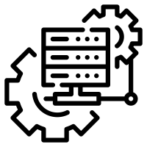
System Tests
System tests
Test the entire system: all its components together (front-end + back-end + database + other components)
Example: user registration from mobile app should store the new user in the DB
Automated system testing uses DevOps tools to setup the testing environment
System tests are part of the CI/CD pipeline
Notes:
System tests and acceptance tests test the entire system: all its components together.
System tests are manual or automated tests, which cover end-to-end scenarios:
from the front-end, to the back-end, the database and all other system components.
System testing is performed late in the development process,
when the entire system is ready or partially ready.
System testing is usually performed by QA engineers or test automation engineers (software developers in test).
For example, if we test whether after user registration in the mobile app of complex software system,
the new user is correctly stored in the database at the server side, this is a system test.
This system test checks all system components together:
the user interface (the front-end), which is the mobile app in our scenario,
the back-end services at the server side, which are called by the mobile app,
the data access logic, implemented in the back-end to access the database,
and the database server, which stores the app data.
To implement this system test, QA engineers
run the software in a testing environment,
create a database, holding sample testing data,
run the back-end server-side components,
run the front-end components (the mobile app in our scenario),
fill some data in the user registration form, submit the data,
and check the behavior of the mobile app,
then check the data stored in the database.
The above steps can either be done by hand (manual system testing)
or can be automated (automated system testing).
Automated system testing can be implemented by using DevOps tools and techniques (like Docker and containers)
to automatically deploy and run the required system components
and perform UI tests in the mobile app, using a mobile testing framework.
Modern development processes integrate system testing in the CI/CD pipeline.
Projects with less QA resources implement automated smoke tests during the system testing phase.
The smoke tests check whether the most important functionality works in the most common scenarios.
They just check whether the system is broken or not, without verifying each of its functions.
An example of smoke test could be to check whether the home page of the system opens correctly.
Projects with more QA resources automate the testing of the entire system
with all its functionality, covering all its use cases.
This approach is heavy and time consuming and is rarely used.
Most modern projects automate the system testing for the most important scenarios only,
not the entire system with all its components.

Slide 23

Acceptance Tests
Acceptance testing evaluates whether the system fully complies with the business and end-user requirements
And it is ready for distribution to end users
Acceptance tests
Test the entire system in the end user's environment
Acceptance tests cover the entire functionality of the software, and all its requirements
Notes:
The aim of acceptance testing is to evaluate
whether the system complies with the business and end-user requirements
and if it is ready for deployment in the production environment.
Acceptance testing is an extension to system testing, where
the QA team or the project sponsor checks how the product will perform
when it is installed on the user’s environment.
Acceptance tests are usually more intensive and more comprehensive than the system tests
and should cover the entire functionality of the software,
together with all its functional and non-functional requirements.
In large formal projects, the acceptance testing is the final milestone before the project is accepted
and is usually contractually linked with the last payment for the project delivery.

Slide 24
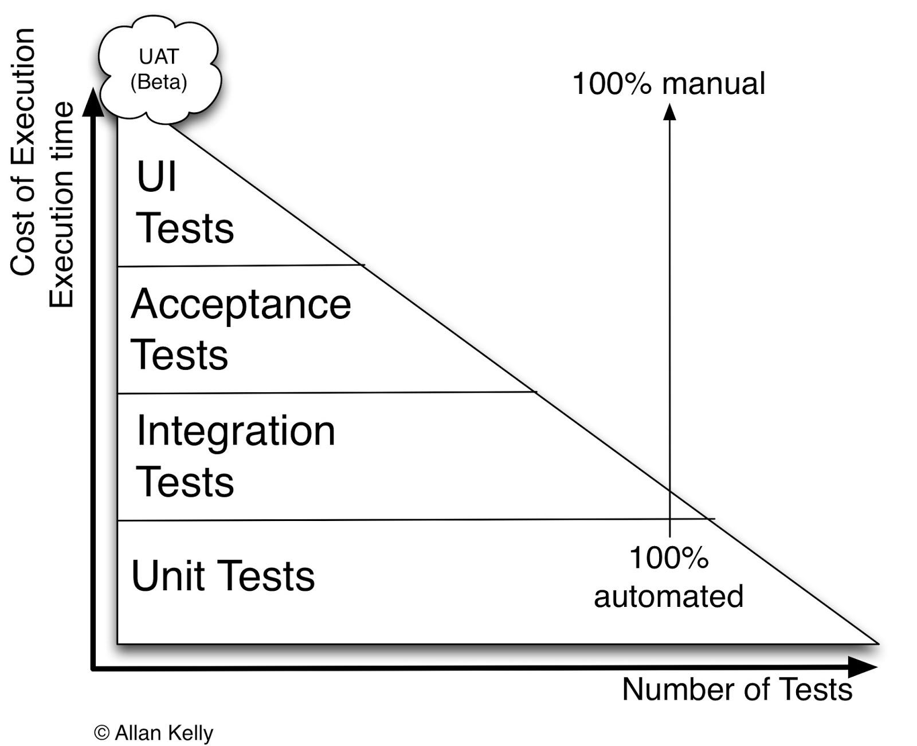
The Testing Triangle
Unit tests: fully automated
Integration tests: fully automated
System tests / acceptance tests: partially automated
UI / UX tests: mostly manual
Notes:
Let's now explain this classical "testing triangle",
which illustrates the relationship between the testing levels,
number of tests, costs of execution and the level of automation.
Unit tests are fully automated.
They make up the biggest part of tests, more than all the others.
Unit tests are written by the developers, when they write the code to implement the smallest units of the system.
It takes small amount of time and effort to execute the unit tests, once they are written.
Integration tests are also fully automated.
They make up the next biggest part of tests.
Integration tests are written by the developers, when they write the code to integrate the units of the system into modules.
It takes relatively small amount of time and effort to execute the integration tests, once they are written.
System tests and acceptance tests are partially automated or are manual.
They make up significantly smaller part of tests.
System tests are manually executed by QA engineers
or are automated by QA automation engineers,
when they test the entire system or certain functionality from the entire system.
It takes significant amount of time and effort to perform the system tests, or to automate them.
UI and UX tests are mostly manual.
They are executed by QA engineers and the project sponsor (who pays for creating the software).
These tests are difficult to automate and usually cost a lot of effort to be performed.

Slide 25
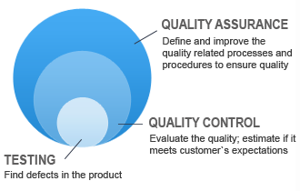
Test Process and Test Activities
Begin
Test Planning
Test Analysis and Design
Test Implementation and Execution
Exit Criteria and Reporting
Test Closure Activities
End
Notes:
Software quality assurance is a broad engineering discipline,
which defines processes, practices and procedures, to ensure the software quality.
QA processes include software testing, defect tracking, continuous integration and others.
Quality control is the process of evaluating the software quality by testing, inspections and other activities,
track the quality over time and take actions to maintain good quality and meet the customer expectations.
Software testing is the process of planning and execution of tests
to assess the software quality, find and report defects.
Testing is not just running tests.
The testing process includes many steps, such as:
planning and control, test design, test implementation, test execution, test evaluation and reporting.
Let's discuss these steps in the software testing process.
At the start, the testing team is involved
in the requirement analysis and early product design.
The next step is "Test Planning". It involves defining
the testing strategy,
the goals of the testing process,
the scope of testing (what to test),
the overall testing approach (how to test),
the exit criteria for the testing process,
scheduling the test design, implementation and execution process (when to test),
and assigning resources for the planned activities.
Test planning is done together with the overall project plan and its milestones,
and is aligned with the other project activities.
The next step is "Test Analysis and Design".
The QA team analyses the product requirements and project assets and
designs the test suits, test scenarios, and test cases for each scenario,
decides what and how to be tested, and to what extent,
and decides on the structure of the test environment, infrastructure and tools.
In iterative development the test analysis and design and the following testing steps are performed
for the currently planned set of features in the current iteration, not for the entire product.
The next step is "Test Implementation and Execution".
At this step, the planned tests are implemented (as test procedure or script)
and are executed (manually or by automation).
Depending on the testing approach, the test implementation consists of
either writing test procedures for each test case,
or writing automated testing scripts for each test case,
or mixing manual test procedures with automated testing scripts.
For each test case the input data and entrance conditions are prepared,
together with the expected results and exit conditions.
The test execution consists of executing the test suits and test cases. This includes:
executing the manual test procedures by hand,
and running the automated testing scripts.
Test execution includes comparing expected and actual results for each executed test case
and reporting each test execution as "success" or "failure".
The output from manual testing is a report, which holds information about the executed tests, passed tests and failed tests.
The output from automated testing is a similar report, but it is automatically generated.
The defects found by the failed test cases
are entered in the issue tracking system for fixing by the development team.
At this step, QA engineers review the test execution results
and close or re-open the pending issues from the issue tracker,
which were covered by the executed tests.
The next step in the testing process is "Checking the exit criteria and reporting".
During this step, the QA team decides when to stop testing (or when to stop writing automated tests).
This decision is usually based on the achieved coverage of the functionality,
code coverage, quality requirements and available resources.
These criteria vary from project to project and are known as "exit criteria" or "acceptance criteria".
Exit criteria for the testing process come into picture, when:
Enough test cases are executed with certain pass percentage.
Bug rate falls below certain level.
When the deadlines are reached.
Finally, a test summary report is prepared for the project stakeholders.
The final step in the testing process is the "Test Closure Activities".
At this step, the QA team checks that planned deliverables are actually delivered,
and ensure that the defects reported have been resolved.
The QA team also creates a final test report
about the performed tests, passed tests, failed tests,
defects found, defects resolved, defects remained unfixed and others.
The goal of the closing activities is to ensure that the testing process was successful,
and the software meets the quality expectations.
The testing process is not straightforward.
Often, at certain step the QA team finds that the previous steps are not performed well enough
and the QA activities continue back from a previous step.
For example, if the exit criteria are not met,
the QA team should design, implement and execute more tests
to evaluate the areas of the software, which are not well covered.
Another example is when during the test closure activities the QA team finds that the
quality expectations are not met, because most reported defects stay open or the test coverage is not enough,
and the testing and bug fixing should continue.
At the end of the testing process,
the software is expected to meet the quality criteria
and to be ready for releasing.
Note that the above testing process is usually
executed many times during the development,
for each feature of the product.
This follows the philosophy of iterative development, which is used in most modern software projects.
Iterative development splits the development into iterations.
At each iteration, the development team plans which features to design, implement, test and release.
At each iteration the QA team executes the above described testing process.
The QAs plan the testing activities, test scenarios, test cases and exit criteria,
design, implement and execute the test suites and test cases,
report the bugs and checks the exit criteria
in order to meet the quality expectations for this iteration.
Basically, this is the QA process for most software project.
Some teams follow it more formally.
Others work less formally.
But testing is always a part of software development and cannot be skipped, even when the team has no QA engineers.
In this case the developers or project stakeholders perform the testing activities.

Slide 26

Test Plan, Test Scenarios and Test Cases
The test plan describes how tests will be performed
List of QA and test activities to be performed to meet the quality requirements (more or less formal)
Features to be tested (scenarios), test cases, testing approach, test schedule, acceptance criteria
Test scenarios and test cases
Test scenarios – stories to be tested
Test cases – tests of certain function
Each test scenario is covered by several test cases
Notes:
Let's explain in more detail
the concepts of "test plan", "test scenarios" and "test cases".
The test plan describes
how and when tests will be designed, implemented and executed.
The test plan also defines the scope of testing and exit criteria
(for example, 80% code coverage for the front-end and 70% coverage for the back-end).
The test plan list of QA and test activities to be performed
to ensure meeting the quality requirements.
These activities can be defined in a more formal way (as document) for bigger teams and projects
or in less formal format (with no formal documentation) for smaller teams and projects.
The test plan specifies:
the features to be tested (the test scenarios)
test cases for each scenario,
the testing approach (manual, automated, mixed),
test schedule (when tests will be designed, implemented and executed),
acceptance criteria (or exit criteria) for the testing process (e.g. 90% coverage),
testing environments, infrastructure and tools.
Test scenarios and test cases are the main entities when QAs plan, implement and execute tests.
Test cases are organized in groups, called "test suits".
Grouping is based on the covered test scenarios, software modules and types of functionality tested.
Test scenarios correspond to the user stories (or functionalities) to be tested.
For example, a test scenario is to test whether the user registration works correctly.
Test scenarios are high-level descriptions of what to test, without much detail.
Test cases aim to test a single function of some software functionality.
For example, a test case can attempt to register a new user with empty username and password,
and check whether the displayed error message is meaningful.
Another test case can attempt to register a user with a duplicated username.
Test cases are described by a sequence of steps,
together with the expected behavior after each step.
By concept, each test scenario is covered by several test cases.
Typically, the first test case checks the usual flow of execution,
for example "register user with valid username and password".
The next test cases typically check the unusual flows of execution,
such as incorrect input, invalid input state, border cases and others.
To ensure that certain functionality works correctly,
we need a set of test cases, which are grouped in test suits.

Slide 27

Test Case
Sequence of steps to check the correctness of something
At least two cases to fully test certain scenario
A positive test
A negative test
Test cases consist of:
Title
Steps to follow
Expected result
27
Notes:
Let's look what's inside a test case.
Test cases are the smallest entity in software testing.
A test case holds a sequence of steps to check the correctness of something.
A set of test cases covers certain software functionality (or user story).
A single test case tests a part of certain software functionality,
where certain input data and input conditions are carefully prepared
to test some specific aspect of this functionality.
At least two cases should be designed, implemented and executed
to fully test certain scenario: positive and negative test.
The "positive test" is the first (and most important) test case.
It checks the usual workflow, when the input data and conditions are valid
and the software should successfully perform the requested operation.
An example is to register a user with valid data.
The "negative test" is the second (and less important) test case.
It checks the unusual workflow, when the input data or input conditions are invalid
and the software should fail to perform the requested operation
and should return an error.
An example is to try to register a user with empty username.
For most scenarios, the unusual workflows are multiple,
so the negative test cases should be several, for higher coverage.
Examples of other negative test cases for the previous scenario are to:
try to register a user with duplicated username,
try to register a user with too long username (like 1000 chars),
try to register a user with empty password.
Test cases consist of:
Title: this is a short one-line description, which explains what we test,
such as "Register user with duplicated username".
Steps to follow:
These are the instructions how to conduct the test, expressed as sequence of steps.
Each step describes an action to be executed,
such as "Open the user registration page"
or "Enter 'peter' in the username text box".
Steps may have pre-conditions and post-conditions (expected result).
Expected result:
It describes what should happen when we execute the described steps.
If during the test case execution, the actual result is different than the expected result, we have a failing test.
When a test is failing, the QA should check whether the test is incorrect, or the software demonstrates a defect.
Defects should be entered in the issue tracking system.
The expected result can be only one, after all the performed steps,
or separate expected result could follow each step in the test case.

Slide 28
Test Scenarios and Test Cases – Example
Sample test scenario:
User registration
Test cases for this scenario:
Valid data & free username → success
Duplicated username → error
Empty username or password → error
Too long username or password → error
Invalid characters in username / password → error
User Registration
Username:
maria
Password:
•••••••••••
Full Name:
Maria Steward
Register
Notes:
Let's take a real-world example of test scenario and test cases, which cover this scenario.
Our sample test scenario is "user registration".
The expected functionality is illustrated at the screenshot on the right.
To cover this test scenario, we should design and implement several test cases:
The first test case is the "usual workflow" (the positive test),
when we have valid input data and free (non-duplicating) username.
In this case we expect the "Register" operation to succeed
and the new user to be successfully registered.
The next few test cases cover the unusual workflows for the "user registration" scenario (the negative tests).
The next test case attempts to register a user with duplicated username.
The registration process should fail and display appropriate error message.
The next test case attempts to register a user with empty username or password.
This is also the case when the username or password hold only spaces and tabs.
The registration process should fail and display appropriate error message.
Another unusual test case is to attempt to register a user with too long username or password.
The registration process should fail and display appropriate error message.
Yet another unusual test case is to attempt to register a user,
when the username or password hold invalid characters.
The registration process should fail and display appropriate error message.
If the "full name" field is required, then we should also check it:
With empty or invalid full name and with too long full name.
This is how the simple test scenario "user registration"
is implemented with a set of test cases,
which test the various situations, which may arise, when we register a user.

Slide 29
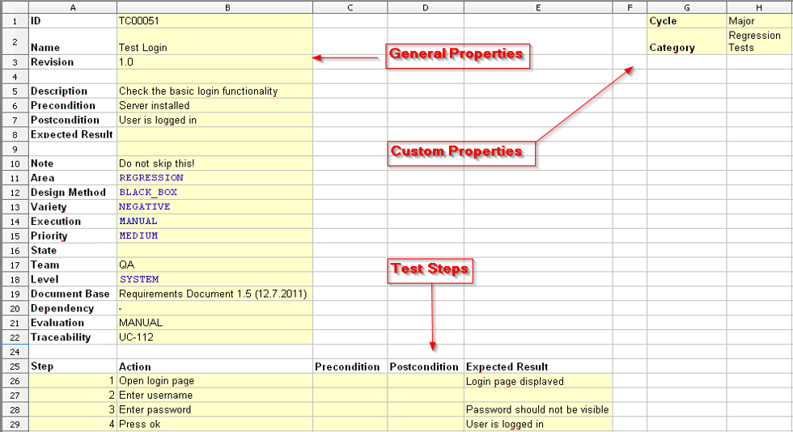
Test Case – Formal Example
Notes:
This is an example of formal test case description.
In this example we have the "user login" scenario with the usual workflow of "login valid user".
The test case name (or title) is:
"Test Login".
The description of the test case is:
"Check the basic login functionality".
It has some attributes, such as:
design method: black box,
execution: manual,
priority: medium,
and few others.
It holds a sequence of steps to be executed:
Open the login page and expect that it loads correctly.
Enter username (and expect that it will enter correctly).
Enter password (and expect that the password will be invisible, shown as stars).
Press the login button and expect the login is successful and the welcome screen is shown.
Note that the above format of describing test cases is too formal.
In practice test cases are either described in less formal and less descriptive form,
mostly at the level of test scenarios,
or are stored in a specialized test management software,
such as IBM Rational ClearQuest, TestRail, PractiTest and Zephyr.

Slide 30

Test Plan
Live Demo
https://melodic.cloud/wp-content/uploads/2019/01/D5.06-Test-Strategy-and-Environment.pdf
https://www.smartdcc.co.uk/media/3609/testing-approach-document-for-june-2020-release_v03-clean.pdf
Notes:
In this example I will show you two examples, which demonstrate how a test plan might look like.
I should first mention that formal test plan document
is used only in big organizations,
which develop big and heavy software projects (with hundreds of participants).
Smaller projects use more agile and less formal test planning process
and they usually don’t create such test plan document.
Let's open the first link.
This document presents a strategy for testing, acceptance criteria, test related products and responsibilities related to quality assurance tasks in Melodic (which is a cloud management and optimization platform).
Let's jump to the table of contents. It holds:
test strategy and scope of testing,
levels and types of testing (unit testing, smoke testing, functional testing, regression testing, non-functional testing),
test environments (development, integration and acceptance environments),
test process and acceptance criteria,
bug tracking and testing tools.
We can scroll down to quickly review what's inside.
I will not get into more details.
I just want to show you a sample test planning document.
Let's see the second example. We open the second link.
It holds a heavy, formal test planning document, from the energetics industry.
Let's jump to the table of contents at page 6.
The document describes:
the testing objectives,
the planned testing approach,
testing phases and activities,
testing procedures,
test result management and reporting,
acceptance criteria,
issue tracking and management
and other topics.
We can scroll down to quickly review what's inside.
I will not get into more details.
My goal was just to show you how a formal test planning document may look like.
Remember that most organizations are not so formal,
and their testing process is lightweight,
and does not maintain formal documentation.

Slide 31
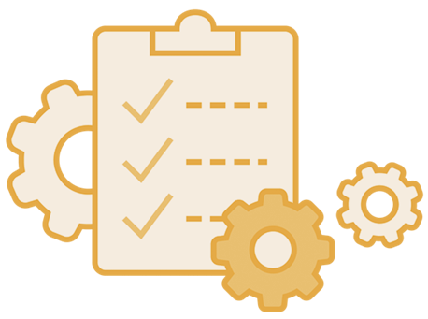
Test Automation
Unit Testing, Integration Testing, Mocha, Selenium
Notes:
It's time to get into more practice.
In this section I will explain and demonstrate the concept of automated testing with live code examples.
I will introduce the basics of test automation
and test automation frameworks and tools.
I will explain the role of "test automation engineers" in the software development process,
their responsibilities and skills.
Next, I will explain the concept of "unit testing" and "unit testing frameworks",
and will demonstrate how to write test suites and test cases with Mocha,
which is a popular JavaScript unit testing framework.
I will then continue with the concepts of "integration testing"
and will demonstrate how to write an integration tests in JavaScript.
Finally, I will introduce the concept of Web UI test automation
and will demonstrate how to write automated Web UI tests with Selenium WebDriver.

Slide 32
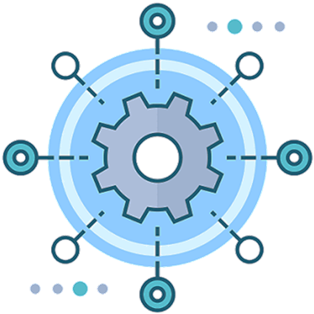
Test Automation: Levels and Tools
Test automation is an important part of software development
Test automation is done at many levels:
Unit tests: written by developers
Integration tests: written by developers
System tests and UI tests: written by QAs
Test automation tools simplify writing, recording and executing automated tests
Testing frameworks (JUnit, NUnit, Mocha, …)
Automated UI testing tools (Selenium, Appium, Sikuli)
Web testing, API testing, mobile testing
Notes:
Test automation is an important part of software development.
Big software products and systems (like MS Office and Gmail) are tested automatically.
With test automation software systems maintain their quality over time.
Automated tests are repeatable and once written, they stay for a long time and are executed thousands of times.
Automated tests are executed as part of the continuous integration system, after each major change in the code.
Thus, automated tests find the bugs in the code early and prevent them reaching the end users.
Test automation is done at many levels, such as unit testing, integration testing and system testing.
Unit tests are automated tests written by developers.
Unit tests check the functionality of isolated components of the software.
Unit tests are written by developers to test a single method or function in the code.
Unit tests are easy to be automated: they invoke the target component with a predefined input data and check the execution results.
Integration tests are automated tests, which check the functionality of several software components together.
Integration tests cover bigger areas of the code, compared to unit tests.
Integration tests are written by developers, to ensure that certain sets of components work as expected.
Automated integration tests are pieces of code, which setup a testing environment, prepare input data and input state, execute certain functionality and check for correctness the produced results and output state.
System tests and UI tests are usually performed by QA engineers.
System tests test check certain functionality of the entire system, with all its interacting layers, modules and components.
Systems tests can be executed manually (by hand) or can be automated.
Automated system tests are pieces of code, which setup a testing environment, deploy the system with all its layers, modules and components, fill sample data, prepare input data and input state, execute certain functionality and check for correctness the produced results and output state.
Automated user interface (UI) tests automate the Web browser or the Desktop or mobile app with code to simulate user interaction (such as clicks on the UI elements), and check whether the software behaves as expected.
Test automation tools simplify writing, recording and executing automated tests.
Such tools can simplify writing automated tests by providing platforms, frameworks, libraries, APIs for test automation.
Some test automation tools allow recording the user behavior (such as UI interaction and API calls) and can automatically repeat the recorded steps, or even generate source code to repeat the recorded steps.
Testing frameworks (such as JUnit, NUnit, Mocha, PyTest, Cucumber and many others) provide an environment and building blocks for writing and executing automated tests.
Testing frameworks define a way to define and implement test cases and test suites.
They also define the format in which to express expectations (the so-called assertions)
Provide a functionality to setup the testing environment before test execution and shut it down after the test execution.
Provide a mechanism to hook into or drive the application under test, for example, control the user clicks over the app UI.
Provide functionality and UI for executing the tests and reporting the test execution results.
Automated UI testing tools (such as Selenium, Appium and Sikuli) provide an API, libraries and tools to automate the testing of Web, mobile, desktop or other user interface.
UI testing tools allow recording and executing scripts, which simulate user interactions with the app under test.
QA engineers can record test cases using a test recording tools.
Later, the recorded test cases can be executed, and the produced results can be checked and analyzed.
Selenium WebDriver is an excellent example of UI testing framework. It runs a Web browser and controls it to load Web apps, click on their UI, fill and submit forms, simulate user interactions and check the obtained results. I will show you an example of Web app test automation with Selenium later.
Appium is an example of mobile app testing framework, which can control mobile apps and simulate interactions with their UI.
Sikuli is another example of UI test automation tool, which implements UI automation, based on image recognition of UI elements.
Test automation tools can automate the testing of front-end apps (such as Web apps, mobile apps and desktop apps), back-end apps and components (such as Web APIs, RESTful APIs, and APIs based on other protocols) and others.
Web testing automates the Web app execution inside a Web browser. It is usually implemented through the WebDriver protocol, supported by modern Web browsers and tools like Selenium.
Mobile testing automates the mobile app execution inside a mobile device simulator or native mobile device (such as iOS or Andorid device) and is usually implemented through the WebDriver protocol for mobile and mobile testing tools such as Appium.
API testing automates testing of back-end APIs, such as RESTful Web services. It is implemented by tools like SoapUI and Postman.
Test automation tools dramatically simplified the job of writing and executing automated code-based tests for your apps and is part of most serious software projects today.

Slide 33
Test Automation Engineers
Test automation engineers (software developers in test)
Developers with QA automation specialization
Technical skills: coding, OOP, Web technologies, front-end, back-end, databases, services and APIs, software engineering, etc.
QA skills: testing frameworks and test automation tools
DevOps skills: containers, cloud, CI/CD pipeline
Logical thinking and problem-solving skills
Planning and organizational skills
Attention to details
Notes:
Test automation engineers are software developers, who are focused on software test automation.
They are also called software developers in test.
Software developers in test are developers with QA automation specialization.
They combine technical, coding, QA, DevOps and soft skills.
Test automation engineers have strong technical skills in software development:
Programming skills, writing code, using APIs and libraries, using back-end and front-end technologies
Object-oriented programming (OOP), classes, interfaces, inheritance, polymorphism
Web technologies and front-end: HTTP, HTML, CSS, JavaScript, JS frameworks
Back-end technologies, databases, services and APIs, REST
Software engineering, development methodologies and understanding the software development lifecycle (SDLC)
Software developers in test have strong QA skills.
They have deep understanding and experience with different testing frameworks (such as Junit and Mocha) and test automation tools (such as Selenium and Appium)
They understand very well the software testing process, different test levels, test types, testing approaches and how to design test cases
Test automation engineers have DevOps skills.
They use containers, Docker and other platforms to implement the continuous delivery, continuous deployment and continuous testing.
They often use cloud infrastructure to build the test automation environments.
They implement and maintain the CI/CD pipeline for the project.
QA engineers have logical thinking and problem-solving skills.
Designing the test cases and feature coverage, analyzing the root cause for software faults and building the CI/CD pipeline requires strong logical thinking and serious engineering approach.
Planning and organizational skills, as well as communication skills are important for QA engineers,
because they are deeply involved in the software development process and constantly communicate with the other team members.
QAs engineers are often involved in project planning, project tracking, meetings and other organizational and management activities.
QA engineers should have strong attention to details.
This means, for example, to notice when two spaces are accidentally placed in the text, instead of a single space.
This means, also, to notice when two buttons are not equally aligned in the user interface.
This means, also, when writing automated tests, to check all important use cases, without skipping most of them.
This means, also, when writing a bug report in the bug tracker, to be detailed and write in understandable way.
Attention to details is a way of thinking: to think for high quality, without defects, even in the smallest details.

Slide 34
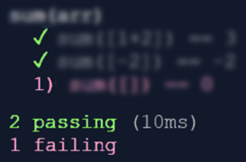
Automated Testing
Automated test == a piece of code that tests specific functionality in the software
Unit test, integration test, system test
function testSum() {
if (sum([1, 2]) != 3)
throw "1+2 != 3";
if (sum([-2]) != -2)
throw "-2 != -2";
if (sum([]) != 0)
throw "empty sum != 0";
}
function sum(arr) {
let sum = 0;
for (let item of arr)
sum += item;
return sum;
}
Notes:
Automated testing is an important concept and practice in software development.
It can be applied at different test levels: unit tests, integration tests, system tests and others.
Unit tests are pieces of code that test specific functionality in certain software component, called "unit".
Integration tests are pieces of code that test several software components together and their integration.
Automated system tests are pieces of code, which test certain functionality of the entire system, with all its front-end and back-end components together.
Automated tests are part of the product source code.
They are written by developers and QA automation engineers and are usually a part of the CI/CD pipeline.
Automated tests aim to improve the code quality, reliability and maintainability.
This is a simple example to illustrate the idea of "automated testing":
We have a function, which sums the elements of given array of numbers.
We want to test this function, but by code, not by hand.
We want to write code, which confirms that this function is working properly.
This is a "unit test", because it tests a single unit (a simple function in the code).
This is an example of how we can test the "sum" function:
We write a function to hold the test cases.
This is the first test case, the first check.
It checks whether the sum of the array of two elements [1, 2] is 3.
If the execution result is not as expected, the function will fail with an error message.
The second test checks whether the sum of the array, holding a single element [-2] is -2.
The third test checks whether the sum of an empty array is 0.
This example is just a simple way to illustrate the concept of "unit testing" as an example of test automation.
Don't follow it as best practice. It is not!
It combines multiple test cases in a single test function, and this is a bad practice.
But the idea of automated testing is clear:
Automated tests execute the code with sample input data and entrance conditions
and check whether the returned result, exit conditions and behavior are correct.
Automated testing usually is performed within a software testing framework,
which organizes and structures the tests consistently.

Slide 35

Software Testing Frameworks
Software testing frameworks simplify, structure and organize the automated testing process
Provide programming model for writing tests
Provide test execution and reporting tools
Implement unit testing, integration testing, UI testing, database testing, API testing and others
Examples: Mocha, JUnit, NUnit, unittest
Testing frameworks are sometimes called "unit testing frameworks"
Notes:
Software testing frameworks simplify, structure and organize the automated testing process.
They provide a programming model to write tests,
and tools to execute tests and generate test execution reports.
Testing frameworks are used to implement
unit testing, integration testing, UI testing, database testing, API testing and other types of automated testing.
Developers use the testing framework
to structure the tests,
to organize them in a hierarchy using classes and functions,
to assert the execution results and exit conditions for correctness,
to handle some specific situations (like "expected error" or "expected timeout")
and to automate some aspects of the testing process
(like initializing the testing environment at startup and cleaning it up at shutdown).
Examples of software testing frameworks are:
The "Mocha" testing framework for JavaScript,
the "JUnit" testing framework for Java,
the "NUnit" testing framework for C#,
and the "unittest" framework in Python.
Automated testing frameworks, such as JUnit and NUnit,
are sometimes referred as "unit testing frameworks",
but this name is not fully correct.
It is misleading.
Unit testing frameworks provide general infrastructure to write and execute automated tests
and can be used to write also integration tests, API tests and other automated tests.

Slide 36
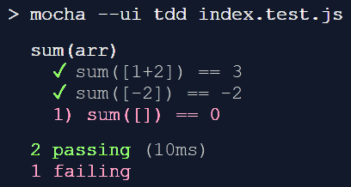

Unit Testing with Mocha – Example
Mocha is a JavaScript testing framework
Supports TDD, BDD, test suits, test cases, reporting
const assert = require('assert');
suite('sum(arr)', function() {
test('sum([1+2]) == 3', function() {
assert.equal(sum([1, 2]), 3); });
test('sum([-2]) == -2', function() {
assert.equal(sum([-2]), -2); });
test('sum([]) == 0', function() {
assert.equal(sum([]), 0); });
});
Notes:
Mocha is a JavaScript testing framework,
that can tun server-side in Node.js and client-side, in the Web browser.
It supports the major styles of writing tests:
test-driven development (TDD) and behavior-driven development (BDD).
Mocha can structure the tests into test suits and test cases,
provides test execution and reporting.
This an example of how the test cases from the previous example can be structured within the Mocha testing framework for JavaScript.
We first include the required libraries.
Then we define a "test suite".
This is a group of related tests.
Within the test suite we define our first test.
It holds a function to check whether the sum of the array [1, 2] is 3.
The second test follows the same syntax:
It checks whether the sum of the array [-2] (a single element) is as expected: -2.
Similarly, the third test checks whether the sum of the empty array is 0.
That's all.
When we run the tests, we see a test execution report like this, shown on the screenshot.
It displays information about the executed tests, passed tests and failed tests.
Failed tests come with technical information about what has failed: error message, file name, line number and others.
Developers should be familiar with automated testing and testing frameworks, even junior developers!
We shall learn in detail the concept of "unit testing" and how to use unit testing frameworks,
how to write efficiently unit tests and integration tests,
how to use tools like "code coverage" and "mocking"
in the advanced programming training modules at SoftUni.

Slide 37
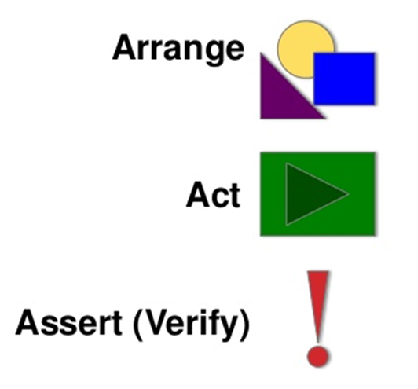
The Arrange-Act-Assert Pattern
The "AAA" pattern in automated testing
Arrange – prepare input data and entrance conditions
Act – execute the operation for testing
Assert – check results and exit conditions
let input = [1, 2];
let output = sum(input);
assert.equal(output, 3);
Notes:
Perhaps, I need to mention, that unit testing has not only its technical side:
which is to use correctly the testing frameworks and libraries.
It has also its engineering side:
to decide what and how to test.
Unit test writers usually follow the "AAA pattern",
which is short for "Arrange, Act, Assert".
First, arrange the input data and entrance conditions.
At the example we prepare a sample input data, an array of integers: [1, 2].
Then, act. Execute the operation, which you want to test.
At the example we invoke the "sum" operation with the prepared input.
Finally, assert whether the results and the exit conditions are as expected.
In our example we assert that the actual result (the obtained sum) matches the expected result (the value 3).

Slide 38
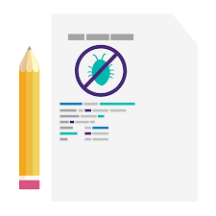
Test Design
Testing usually covers:
the straightforward case
the edge cases
testing for performance, for error handling, etc.
Test cases should be enough to find the bugs
But not too much == without redundancy
Code coverage tools measure
to which extent the tests cover the code
Notes:
When developers and QA engineers design tests,
they typically cover the usual and unusual cases and special situations.
Testing starts from
the straightforward case – the typical use of the function or component (such as array of 2 integers in our example).
To test extensively the code, we need to cover also
the edge cases – the exceptions from the typical case (such as empty array or negative numbers in our example).
Additional test cases could include testing for performance, for error handling, etc.
In our example summing a missing array (a null value) should cause an error.
Testing should be enough to find the bugs and potential problems
but not too much, because it takes time to write and maintain the test cases.
Writing redundant tests is a bad practice.
Tools for measuring the so called "code coverage" measure to which extent the tests cover the code.
Code coverage tools can give a good sign whether a function is tested enough or not.
After execution of the tests, the code coverage tools color the executed lines in green and the others in red and yellow.
Thus developers and QAs can see visually which lines were not tested.
A code coverage of 80%-90% is considered good.
For critical functionality, the code coverage should be nearly 100%.
For functionality, which is not quite important, the code coverage could be small (10%, for example).

Slide 39
Unit Testing with Mocha
Live Demo
https://repl.it/@nakov/mocha-unit-test-example-js
Notes:
Now let's see the process of unit testing with the Mocha framework in a live code example.
We open the link to the sample project at repl.it.
It takes some time to load, as usually.
The file "index.js" holds the function we want to test.
The file "index.test.js" holds the unit tests.
We run the code example.
The output is a colorful report on passed and failed tests.
One of the tests seems to have failed: the empty array test.
If we look at the code of the "sum" function, we shall find the problem.
It starts from the element at position 0, which does not exist in empty arrays.
We can fix the bug and run the tests again.
I shall leave this exercises for you.

Slide 40
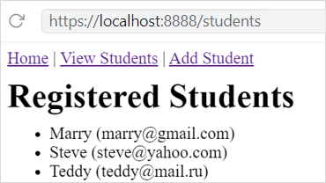
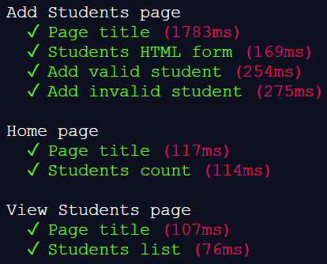
Integration Testing with Mocha – Example
setup (function() {
let students = …;
server.listen(8888);
});
test('Students list', async function() {
let res = await fetch(
"http://localhost:8888/students");
let body = await res.text();
let studentsFound =
body.includes("<ul><li>…</li></ul>");
assert.equal(studentsFound, true);
});
Notes:
This is an example of how an integration test could be implemented, using JavaScript and Mocha.
The app we want to test is a simple registry of students.
It displays a list of students and can add a new student.
At start, integration tests usually setup a testing environment, where the tested components are installed and run.
This is the first step in the integration testing.
In our example,
we define a hard-coded list of students, which will be shown by the app.
and we start the Web app, which will be tested, locally, on port 8888.
The app will be available from https://localhost:8888/.
The next step is to define the test suits and test cases.
We define our first test case named "Students list".
The test will use the classical Arrange-Act-Assert (AAA) pattern.
First, we arrange the input data.
This is already done globally for all test cases, during the setup() function.
As next step we act.
We fetch the students page from the Web app, which is under test, using an HTTP GET request.
Then, we get the response from the Web server.
Finally, we assert that the page holds the expected list of students,
which was initialized in the setup() function.
This is an integration test, because the test invokes several system components, which depend on each other:
The Web sever, which holds the /student page.
The MVC controller function, which handles the HTTP request for the "students" page.
The templating engine, which renders the "students" view.
For simplicity, we don't have a database in this app.
Instead, the app holds the list of students in a simple array of objects,
In real world scenario, we would have also a database, holding the students and we would initialize the database with sample hard-coded data at startup.
When we run the tests, the output from Mocha would be like it is shown on the right.

Slide 41

Integration Testing with Mocha
Live Demo
https://repl.it/@nakov/mvc-app-node-express
https://repl.it/@nakov/MVC-app-integration-tests-example-mocha
github.com/nakov/MVC-app-integration-tests-example-mocha/actions
Notes:
Now let's see the previous example of integration testing with the Mocha framework in a live code example.
We open the first link at repl.it.
It takes some time to load, as usually.
This is а sample Web app that we want to test with Mocha and integration tests.
We run the app. It takes some time to start.
We open the app in а new window.
This is the [Home] page.
It shows the number of registered students.
We click [View Students].
It loads the "Students" page, which holds a list of students (name + email).
We click [Add Student].
It shows a form for adding a new student.
If we submit an empty form, we see a red error message.
If we enter "Nakov" as name and "nakov@softuni.org" as email and we submit the form, the new student is added and is shown at the end of the list.
This is all we have for testing in this Web app. It is quite simple.
Now we open the second link, which holds the same project at repl.it, with integration tests added to it.
Let's see what's inside.
We open the "tests" folder. It holds the Mocha tests.
Let's see what's inside the setup-tests.js file.
It holds the setup() function, which is invoked before each test case.
It defines a list of hard-coded students: Steve and Tina.
Then it starts the Web app locally, at port 8888.
This code will be executed at the beginning of each test.
We have also a teardown() function, which stops the Web server.
This function is invoked at the end of each test.
Let's look at the file home.tests.js.
It holds the integration tests for the Home page.
We have two tests.
The first test is named "Page title".
It loads the app home page and checks its title.
The second test is named "Students count".
It loads the app home page and checks whether the number of students in the app is 2.
Recall that we have 2 students, which are hard-coded in the setup() function: Steve and Tina.
Let's look at the file view-students.tests.js.
It holds two tests.
The first test loads the students page and checks its title.
The second test loads the students page and checks whether the students listed in it are "Steve" and "Tina".
The most interesting file is add-student.tests.js, because it implements the most complex integration testing scenarios.
It defines 4 tests.
The first test checks the page title.
The second test checks the "Students" HTML form and whether it holds the expected input fields.
The third test adds a valid student (Peter with email peter@gmail.com) using an HTTP POST request and checks whether the returned Web page contains the new student in the list of students.
The fourth test tries to add an invalid student (Kate without an email) and checks for the expected error message. It also ensures that at the home page, the number of students stays unchanged.
We have no more tests.
Now it's time to run the tests.
We have 8 passing tests, displayed in green.
We can now break the app to see what happens
Let's edit the students-controller.js file.
We change the code "res.render('home', model)" with "res.render('home2', model)".
and we run the Mocha tests again.
Now we have 5 passing and 3 failing tests.
The failing tests are the tests, which invoke the home page, because it now has a bug and does not render correctly.
Now we fix the bug and run the tests again.
All of them now pass correctly and are displayed in green.
This is how integration testing works:
We arrange some input data and entrance state.
The we invoke certain operation, which covers several system components.
Then we assert that that output and exit conditions are as expected.
To simplify the tests, we reset the server state at the beginning of each test in the setup() function.
This way the tests are independent from each other and their order of execution is not important.
Now, I will demonstrate how we can automate the test execution in GitHub Actions.
We have the same project in a GitHub repository.
We want to automatically build the project and execute the tests on each push in the master branch.
Wе have defined a GitHub workflow called "mocha-tests" to do this.
Let's see it. We open the third link. It opens the GitHub workflows in GitHub Actions for our project.
Let's view what's inside the last workflow execution from the table on the right.
It was activated by change in the source code (a successful "push" in the "master" branch).
We click on the "build-and-test" job from the list on the left.
And we open the "npm test" step from the executed job.
It holds the test execution results.
We can see that all 8 tests were passing.
Now, let's make a change in the source code to see what happens.
We open the [Code] tab.
We click the [Edit] button for the "README.md" file.
We change something and commit and push the changes.
Now we click on the [Actions] tab and see the automatic workflow execution.
The "mocha-tests" workflow were automatically started.
This is how Mocha integration tests can be implemented as part of the continuous integration system using GitHub Actions.
I hope you understand the concept, not the details, which may change over time.
The concept is that in modern software development, when the code is changed, the tests should be automatically executed.

Slide 42
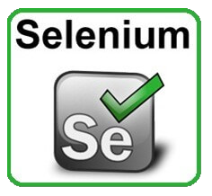
Web Testing Automation and Selenium
System testing tests the entire system:
E.g. front-end (UI logic) + back-end (business logic) + database
Example: automated system testing for Web apps
Auto deploy the Web app in a testing environment (e.g. Docker)
Execute UI test scenarios (e.g. fill and submit forms, then check for the inserted / modified data)
Selenium automates testing of Web apps
Automates the Web browser: test recording + asserts + execution
Notes:
As we already know, system testing aims to test the entire system, with all its components together.
This typically includes the front-end (the user interface logic) + the back-end (the business logic) + the database.
As an example we can take an automated system testing of Web application.
Web applications typically consist of front-end + back-end + database.
System testing should test the UI, which will interact with the back-end, which will interact with the database.
The system testing would include several steps.
First, a script should automatically deploy the Web app in a testing environment (like Docker container or Vagrant virtual machine).
This includes configuring and running the Web server, the database server and other components, and deploying and configuring the Web app in the testing environment.
At this step, predefined sample data should be inserted in the database, because the app cannot work with empty database.
As next step, the automated testing system should execute the UI test scenarios.
This includes to open the app in a Web browser or run the desktop app or install and run the mobile app in a testing environment (like a virtual machine).
Then the automated testing script should click on the app, type text, fill and submit forms and check for the inserted or modified data through the UI or directly in the database.
This UI automation can be implemented with a UI test automation tool like Selenium, Appium or Sikuli.
The last step is to shutdown the testing environment and cleanup.
Selenium is a specialized Web UI testing tool for automated testing of Web apps.
It automates the Web browser through a programming API, which can simulate user interactions,
such as opening URLs, clicking with the mouse, typing text, and others.
Selenium provides tools for test recording, assertions and test execution.
Selenium WebDriver controls Web browsers (such as Chrome and Firefox) through API commands.
It drives a browser natively, as a real user would, either locally or on remote machines.
Selenium IDE records tests and creates test automation scripts for WebDriver in Java, JavaScript or Python.
It is a Chrome and Firefox extension that makes it easy to record and playback tests in the browser.
Selenium is the most popular browser automation tool, widely used by QA engineers for Web UI testing.

Slide 43
Web Testing with Selenium
Live Demo
https://repl.it/@nakov/selenium-webdriver-example
github.com/nakov/selenium-webdriver-example/actions
Notes:
It's time to demonstrate how Selenium browser automation works in action.
We open the first link from repl.it. It may take some time to load.
This is a Python-based project, which uses Selenium WebDriver to run and automate a Web browser.
We shall use Selenium WebDriver to open the Web site https://python.org and test the search form.
Let's see the source code.
The example imports the built-in Python testing framework "unittest".
The setUp(self) method starts the Chrome Web browser.
The first test searches for "pycon" at https://python.org.
It first loads the URL https://python.org in the Web browser.
Then it finds the search box in the currently loaded page by its name.
Then it simulates [Return] key press from the keyboard to activate the search.
The search result is asserted to be different than "No results found".
The second test searches for "missingkeyword" at https://python.org.
The search results is expected to be "No results found".
Let's execute the tests. Run the code example.
You will see visually how the Web browser on the right is automated by the script.
It looks like a real person is running the browser and is working with it, but this is our Python script.
This is how browser automation works.
The same example can be run as GitHub workflow in GitHub Actions.
Open the second link.
It holds an example in GitHub Actions, which executes Selenium tests in a headless Chrome browser (a browser without user interface).
Open the last workflow execution in the table on the right.
Open it and see the execution details.
Look at the Selenium tests and the execution results.
Looks like all tests were passed correctly.

Slide 44

Continuous Integration and Continuous Delivery
The CI/CD Pipeline

Slide 45
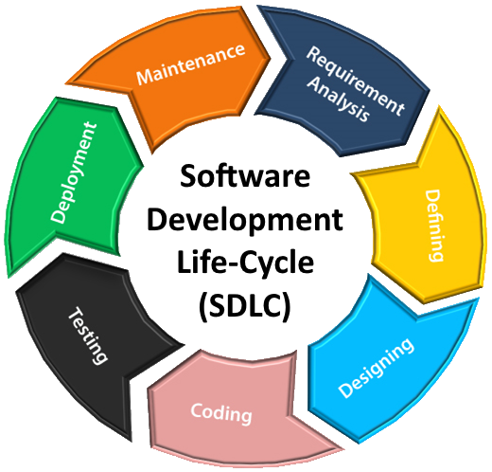
Software Development Lifecycle (SLDC)
Software engineering is not just coding!
The SDLC includes the following activities:
Requirements analysis
Software design
Construction
Testing
Development processes (Waterfall / Scrum / Kanban) define workflow and key practices
Software project management
Release
Maintenance
Notes:
Software engineering is not just coding!
The Software Development Lifecycle (SLDC) always include the following activities (to some extent):
Requirements analysis, software design, software construction, software testing, deployment and maintenance, together with software project management.
Requirements analysis (also called requirements engineering) is the first phase of software projects.
Requirements analysis is the process of determining the business expectations, functionalities and constraints
for a software product, site, app, service or system.
Software requirements define the functionality of the system.
They consist of functional requirements (what the system should do)
and non-functional requirements (like performance and technical constraints).
In software engineering, the requirements are described as formal or informal documentation,
"functional specifications", "user story cards" or "UI prototypes".
Gathering and describing the requirements is the job of the business analysts.
They are the people who talk with the users and project stakeholders
and describe the processes, data flows, and software requirements in a way,
understandable for software developers.
Without clear requirements, writing software is messy and unproductive.
Gathering clear requirements is an important step at the start of any software project,
but it usually lasts to some extent throughout the whole life of the project.
Software architecture and design are the technical plans and blueprints how to implement the software requirements.
The system architecture describes how the system will be decomposed to subsystems (tiers, modules, components, etc.)
and the interaction between these subsystems.
This phase also includes the initial design of the data model (database design).
During the "architecture and design" phase the software architects (or senior developers)
decide on the development stack, platforms, technologies, and tools to be used for development.
The technical design typically gives only the big picture for the system and its structure.
The detailed design is usually created during the software construction, when developers implement the system.
Software construction is the phase in which developers create the software.
It is also called the "implementation phase", because developers write the code to implement the planned functionality.
During the implementation developers not only write code,
but they also debug and test the code, and fix bugs,
take decisions how to implement certain functionalities,
search for libraries and tools for certain functionalities,
design and implement the back-end APIs,
implement the user interfaces of the system,
write automated tests (such as unit tests and integration tests),
and integrate different system components.
The construction takes most of the time and resources during the development.
Software testing and quality assurance confirms that the developed software conforms to the requirements.
Software testing and verification is performed by the quality assurance (QA) engineers.
QA engineers test the code by performing manual and automated testing
and report bugs in the bug tracking system and track the work on fixing the bugs later.
Software release and deployment is the process of building the software packages from its source code,
publishing the new versions of the software on a testing environment,
and after automated and sometimes manual testing, uploading the new version to the production environment.
Release and deployment deals with containers, cloud, servers, builds, installation, configuration and administration of the testing and production environments.
Deployment is usually performed first in a testing environment (a "staging" server), then the product is tested and then deployed in production.
The entire process is typically automated, following DevOps practices and processes.
Software release and deployment is performed by the DevOps engineers (or senior developers),
who write scripts to automate this process and implement the so called "continuous delivery".
Software maintenance is the process of:
monitoring the software and maintaining its normal work,
updating the runtime environments, platforms and libraries,
patching security problems,
bug fixing,
enhancing existing features,
and adding new functionalities to address changing requirements.
Software maintenance is usually a long-lasting process, that is going on for years
and is sometimes mixed with active development of new features.
Software project management is responsible for the planning, scheduling, resource allocation, execution, tracking and delivery of software projects.
Project managers (or software team leaders) are responsible for defining the tasks, prioritizing and scheduling them and tracking and controlling the work progress during the entire software development lifecycle.
Project management is very important for the success of any software project,
so it needs experienced people to handle it responsibly.
All the above-mentioned activities from the software development lifecycle are organized by
software development methodologies, development processes or process frameworks,
such as Waterfall, Scrum and Kanban.
The development process defines the project workflow, development philosophy,
and key management, organizational and engineering practices.
Most systems in modern software engineering are implemented in the spirit of "agile development".
Agile development builds software feature by feature.
Developers iteratively design and build new features, integrate them, deploy them, collect feedback,
fix the problems and proceed with the next feature until the project is completed.
Software development lifecycle, software project management and development methodologies are a broad topic in software engineering,
which developers learn for years during their career growth, as they gain experience.
Junior developers should be familiar with all these concepts but cannot be experts.

Slide 46
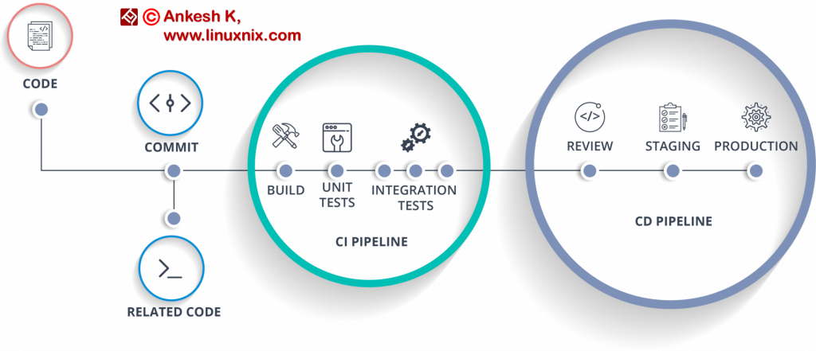
CI/CD Pipeline
CI/CD pipeline
Continuously integrate and release new features
Continuous integration (CI)
Write code, test and integrate it in the product
Continuous delivery (CD)
Continuously release new features
QAs maintain and monitor the CI/CD pipeline

Slide 47

CI/CD Pipeline with GitHub Actions
Live Demo
GitHub Actions
github.com/nakov/MVC-app-integration-tests-example-mocha/actions
https://github.com/fireship-io/fireship.io/runs/924075545
https://github.com/dotnet-architecture/eShopOnWeb/runs/930547025
https://github.com/github/covid19-dashboard/runs/923863536

Slide 48

Summary
…
…
…
QA engineers ensure the software quality: testing, reporting and process
Plan and execute testing activities
Design test cases and execute tests
Write test automation scripts
Report bugs and track their lifecycle
Build and monitor CI/CD pipeline

Slide 49
Questions?
Notes:
49

Slide 50




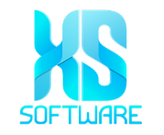









SoftUni Diamond Partners

Slide 51

License
This course (slides, examples, demos, exercises, homework, documents, videos and other assets) is copyrighted content
Unauthorized copy, reproduction or use is illegal
© SoftUni – https://softuni.org
© Software University – https://softuni.bg
Notes:
51

Slide 52
Trainings @ Software University (SoftUni)
Software University – High-Quality Education, Profession and Job for Software Developers
softuni.bg, softuni.org
Software University Foundation
softuni.foundation
Software University @ Facebook
facebook.com/SoftwareUniversity
Software University Forums
forum.softuni.bg
52
Notes:
52

